Slide 1
MedFirst Diagnostic Center Database Design

Slide 2
CONTENT
01
Project Overview
02
Logical Design
03
Data Quality & Security
04
Normalization
05
Entity Relationship Diagram
06
Physical Design

Slide 3
CONTENT
01
02
Database Scripts
Project Summary

Slide 4
01
Project Overview

Slide 5

Project Overview
Business Choice
Goal
Consensus
MedFirst Diagnostic Center
Design a relational database
Chosen for Scope
A diagnostic center & ER providing testing, assessments, and immediate care.
For managing patients, appointments, staff, and test results.
Comprehensive flow from Patients to Doctors to Tests.

Slide 6
Team Collaboration & Roles
Kyle Kopczynski (PM)
Karthik Nittala (BA)
John Perrotti (DBA)
Task management, timeline creation, coordination, and final summary.
Logical/Conceptual Design, Entity identification, Normalization, and ERD creation.
Physical Design, DDL & DML Scripts, and Database implementation.

Slide 7
02
Logical Design

Slide 8
PATIENTS
STAFF / DOCTORS
Demographics & insurance information.
Personnel and role-specific details.
Logical Design
APPOINTMENTS
ASSESSMENTS
Scheduling and visit information.
Evaluations generated from appointments.
We identified 8 core entities to model the diagnostic center's operations, ensuring a comprehensive and normalized data structure.
DIAGNOSTIC_TESTS
TEST_RESULTS
Orders for lab work and imaging.
Outcomes and findings from tests.
CLINIC_INFO
Facility details and operational data.

Slide 9
03
Data Quality & Security

Slide 10
Ensuring Data Quality Assurance
Referential Integrity
Input Validation
Logic Enforcement
Foreign keys ensure all records (Tests, Appointments) link to valid entities, maintaining consistency across the database.
CHECK constraints for formats (e.g., BP `120/80`) and NOT NULL constraints for mandatory fields.
Triggers ensure business rules are followed, such as only Staff with a 'Doctor' role can be in the `DOCTORS` table.

Slide 11
Role-Based Design
The schema distinguishes between DOCTORS, STAFF, and ADMIN roles to control data access.
Auditability
Tracks `ordering_doctor_id` and `reviewing_doctor_id` to maintain a clear record of who authorized and validated tests.
Security & Access Control
Data Privacy
Patient demographics are separated from clinical assessments to support future access control policies and protect sensitive information.

Slide 12
04
Normalization

Slide 13
Achieving Third Normal Form (3NF)
1NF
2NF
3NF
→
→
Atomic Attributes
Full Dependency
No Transitive Dependencies
No repeating groups.
Non-key attributes depend on the full PK.
Non-key attributes don't depend on other non-keys.
Result: Minimized data redundancy and improved data integrity. Example: Zip Code determines City/State, which was kept for address standardization.

Slide 14
05
Entity Relationship Diagram

Slide 15
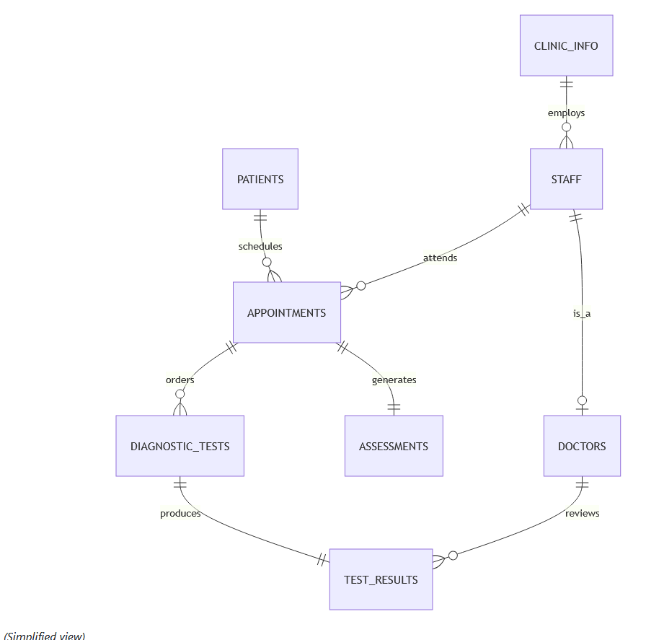
Entity Relationship Diagram (Simplified)
https://github.com/karth878/Database-project/blob/main/MedFirst_ERD.mermaid

Slide 16
06
Physical Design

Slide 17
Physical Design Implementation
VARCHAR2
For text like Names and Addresses.
We converted our logical entities into real Oracle tables, carefully selecting data types for accuracy and efficiency.
NUMBER
For IDs, Temperature, and Pulse.
Turning Plans into Tables
The logical design was translated into a physical schema, ready for implementation.
DATE
For Birthdays and Appointment times.

Slide 18
Primary Keys (PK)
↔
Foreign Keys (FK)
The "Unique ID" for each record in a table.
The "Link" that creates a relationship between tables.
Rule: No duplicates allowed.
Rule: Must reference an existing record.
Example: Every `patient_id` is unique. You can't have two Patient #100s.
Example: An appointment *must* be linked to a real patient in the system.

Slide 19
Business Rules with Check Constraints
CHECK constraints act as automatic validation to prevent bad data from entering the database.
Gender
Severity
Status
Must be 'M', 'F', or 'O'.
Must be a number from 1 (Low) to 5 (Critical).
Must be 'Scheduled', 'Completed', or 'Cancelled'.
CHECK (gender IN ('M', 'F', 'O'))
CHECK (severity BETWEEN 1 AND 5)
CHECK (status IN ('Scheduled', ...))

Slide 20
07
Database Scripts

Slide 21
DDL Scripts
DML Scripts
Data Definition Language for structuring the database.
Data Manipulation Language for working with data.
Tables with full constraints (PKs, FKs, Checks)
Sequences & Triggers for auto-incrementing IDs
Indexes for query performance optimization
Realistic sample data (5+ rows per table)
`INSERT` statements to populate the database
Verification queries to prove data integrity

Slide 22
08
Project Summary

Slide 23
Project Summary & Value
Conclusion
Functionality
Value
Successfully models a complex diagnostic environment, ensuring data accuracy for critical medical records.
Supports essential daily operation queries, from scheduling to reporting test results.
A robust backend is crucial for patient safety, operational efficiency, and data-driven care.

Slide 24
Thank You
We appreciate your time and attention.

Slide 25
THANK YOU
Kimi AI
2025/08/06

